Slide 1

CMR TECHNICAL CAMPUS
UGC AUTONOMOUS
Department of Computer Science & Engineering (AI & ML)
Generating Synthesis Images From Text using RNN&CNN
Project Batch – C4
Name | Roll Number
G.PRASUNA | (217R1A66F0)
T.ABHIJITH | (217R1A66J6)
E.KARTHIK | (217R1A66E8)
Under the Guidance of
Mrs. G.Parvathi Devi
Assistant Professor CSE(AI & ML)

Slide 2
TABLE OF CONTENTS
Abstract
Existing System
Disadvantages
Proposed System
Advantages
Software and Hardware Requirements
System Architecture
Use Case diagram
Class diagram
Sequence diagram
Algorithms
Dataset Description
Result Analysis
Conclusion
Future Scope

Slide 3
ABSTRACT:
Creating synthetic images from text descriptions is a challenging but exciting area in computer vision and language processing. This study introduces a new method that combines Recurrent Neural Networks (RNNs) to interpret text and Convolutional Neural Networks (CNNs) to generate image features. Together, they work to produce realistic images that align well with the given text, effectively capturing both the meaning and context.
This approach benefits from the strengths of both RNNs and CNNs, helping to model the complex connections between text and images.

Slide 4
EXISTING SYSTEM:
4
Existing system for generating images from text use different methods, each with unique strengths and weaknesses. One popular approach is conditional GANs (cGANs), where the model combines text descriptions with random noise to produce images.
Another approach uses Variational Autoencoders (VAEs), which encode text into a latent space that is then decoded to create an image. Some methods also include attention mechanisms to help the model focus on specific parts of the text, aligning it better with the visual output.

Slide 5
DISADVANTAGES OF EXISTING SYSTEM:
Struggle in Semantic
Limited Contextual Understanding.
Issues like accurately matching text to images.
Handling complex descriptions, and producing a variety of realistic images.
Complexity to train the existing models

Slide 6
PROPOSED SYSTEM:
The proposed system introduces a new method for generating images from text by combining the strengths of Recurrent Neural Networks (RNNs) and Convolutional Neural Networks (CNNs).
The RNN processes the text, understanding the meaning and context, while the CNN generates the visual features of the image. By working together, these networks produce images that closely match the text, ensuring a strong connection between the description and the final image.

Slide 7
ADVANTAGES OF PROPOSED SYSTEM:
Handling Ambiguity.
Efficient Scalability.
Enhanced Realism in Generating images.
Semantic Consistency.
Better Contextual understanding.
Superior Performance and Versatility.
Creative Content Generation.

Slide 8
HARDWARE REQUIREMENTS:
SOFTWARE REQUIREMENTS:
System : Pentium IV
Hard Disk : 40GB
Monitor : 15 inch VGA Color.
Ram : 512 MB
Keyboard : Standard Keyboard
Operating System : Windows XP.
Platform : PYTHON TECHNOLOGY
Tool : Spyder, Python 3.5
Front End : Anaconda
Back End : python anaconda script

Slide 9
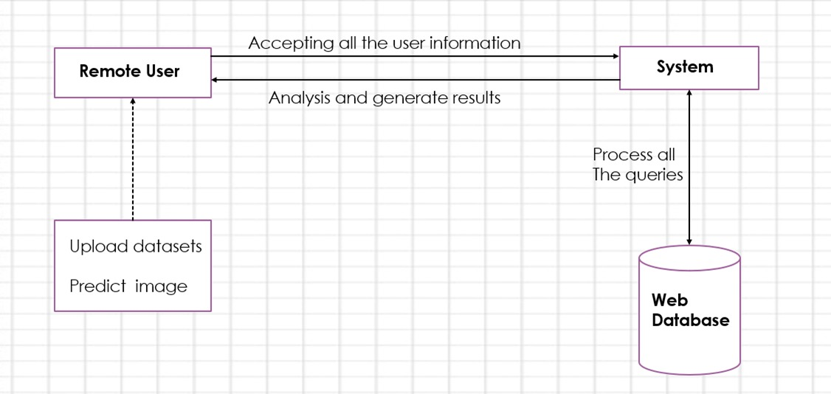
SYSTEM ARCHITECTURE:
9

Slide 10
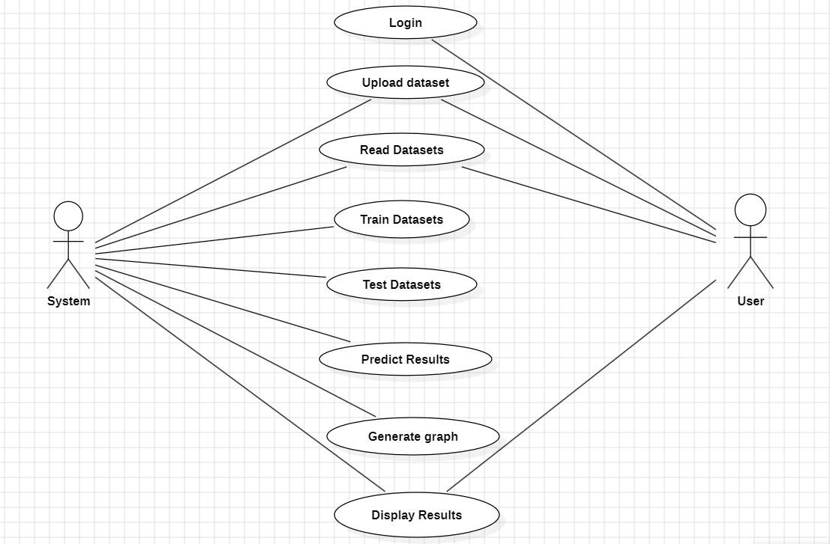
USE CASE DIAGRAM:

Slide 11
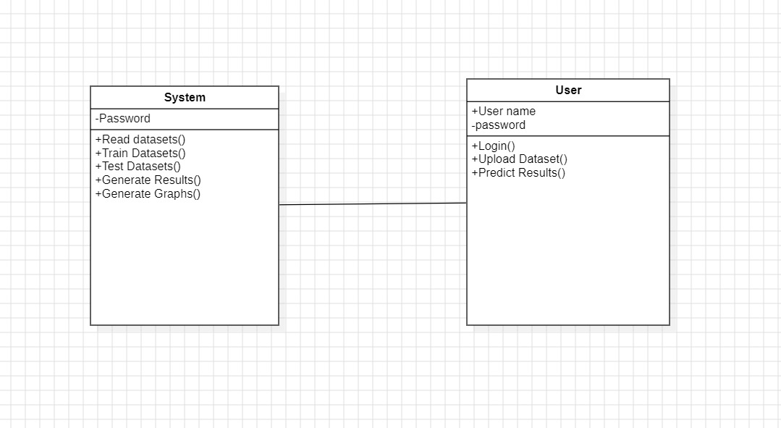
CLASS DIAGRAM:

Slide 12
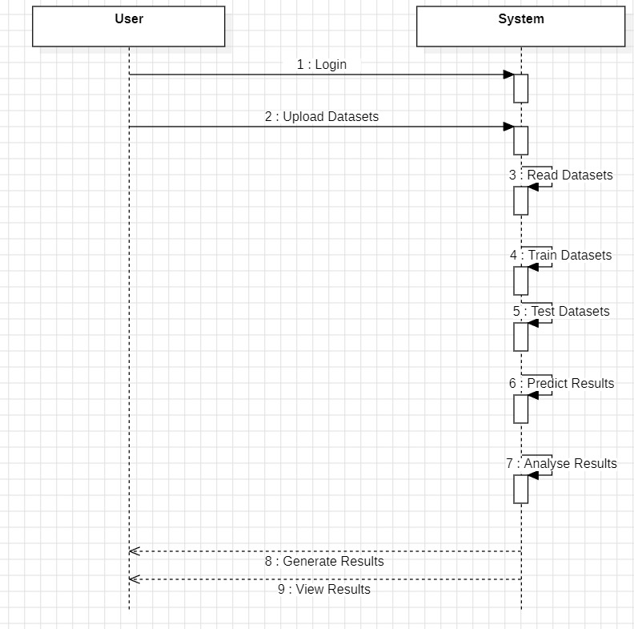
SEQUENCE DIAGRAM:

Slide 13
ALOGRITHMS:
13
1.Recurrent Neural Networks(RNN):
Recurrent Neural Networks (RNNs) play a crucial role in processing sequential data, such as textual descriptions. RNNs are designed to capture contextual information and dependencies in a sequence, making them ideal for understanding the nuances of natural language.
2.Convolutional Neural Networks(CNN):
Convolutional Neural Networks (CNNs) helps in generating realistic and visually coherent images from textual descriptions. CNNs excel at processing visual data by extracting spatial hierarchies and features, such as shapes, textures, and patterns, which are essential for image synthesis.

Slide 14
DATASET DESCRIPTION:
14
The Dataset contains one directory and one text file.
Image directory - contains 8k images with captions .
Text file - contains 5 captions for each Image present in the Images Directory.
Example:1000268201_693b08cb0e.jpg, A little girl climbing the stairs to her playhouse .
https://www.kaggle.com/datasets/kunalgupta2616/flickr-8k-images-with-captions

Slide 15
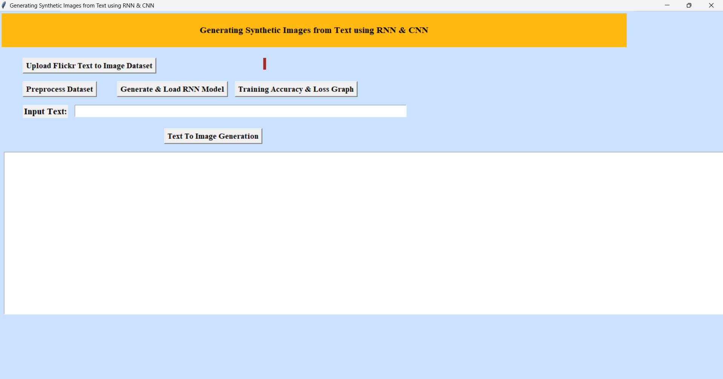
SCREENSHOTS:
15

Slide 16
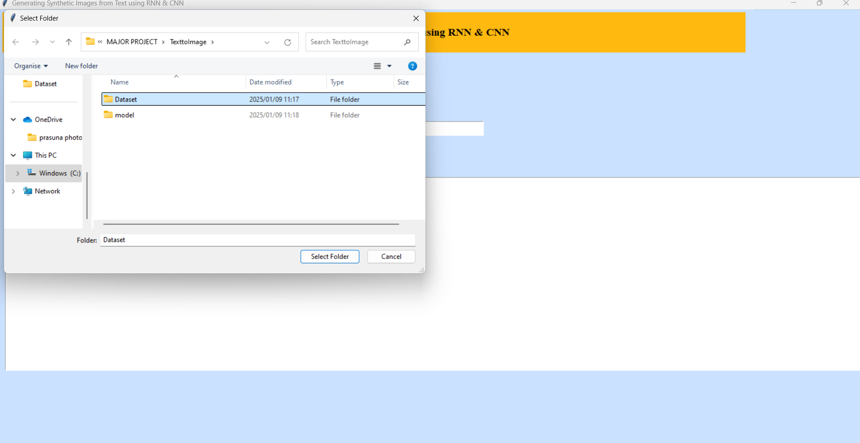
16

Slide 17
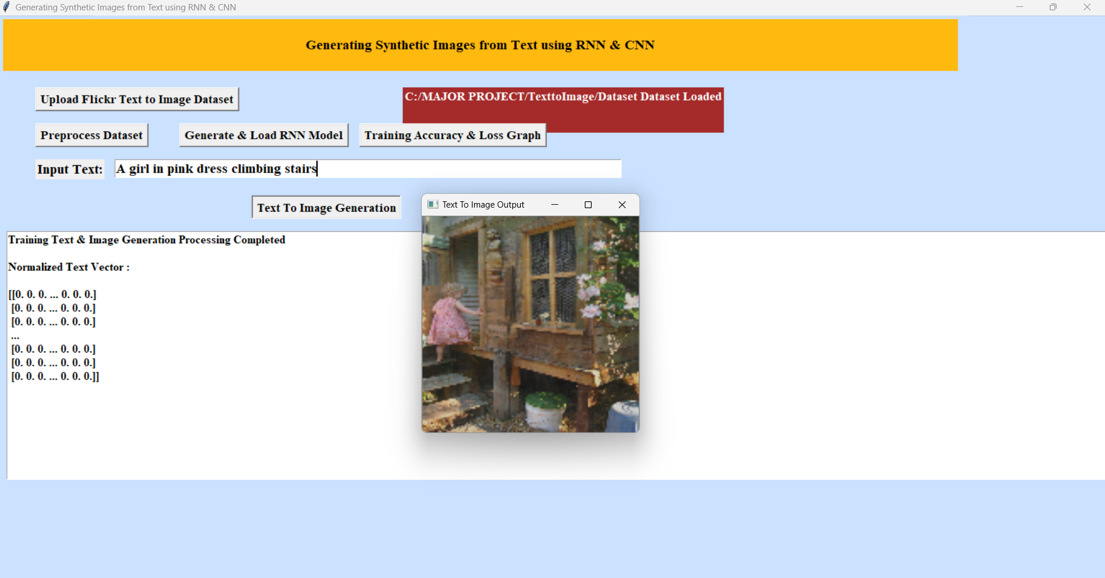
17

Slide 18
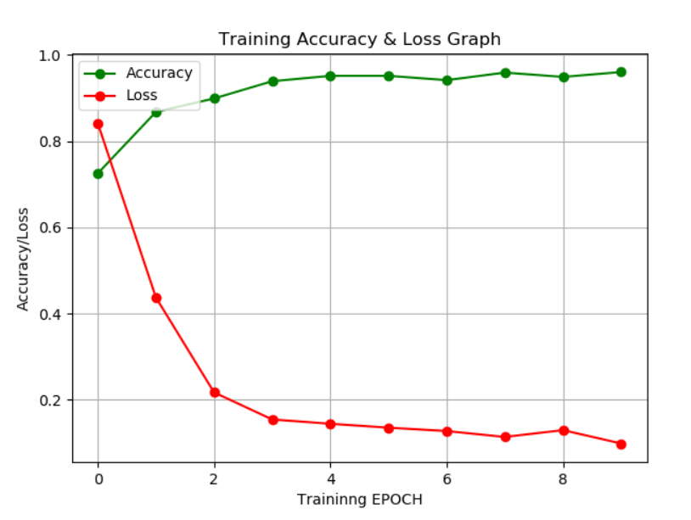
RESULT ANALYSIS:
18

Slide 19
CONCLUSION:
This study introduces a new method for generating synthetic images from text by combining Recurrent Neural Networks (RNNs) and Convolutional Neural Networks (CNNs). Unlike previous methods, such as GANs and VAEs, which often struggle with issues like semantic accuracy and limited diversity, this approach better aligns images with text descriptions, ensuring more realistic and contextually accurate results.
By utilizing RNNs to interpret text and CNNs to create image features, the system captures complex details and handles ambiguous descriptions more effectively.

Slide 20
FUTURE SCOPE:
20
The future scope of a project on "Generating Synthesis Images from Text Using CNN and RNN" is highly promising, with opportunities to Expanding to multimodal capabilities, the project could evolve to generate videos or create images directly from speech and enhance realism and resolution by integrating advanced techniques like GANs. It can be applied in various fields, such as e-commerce for generating product images, entertainment for creating concept art and character designs, and education for visualizing textual concepts. Furthermore, fine-tuning models for specific domains and enabling fine-grained control over generated attributes like style, color, and texture can significantly broaden its impact and usability.

Slide 21
ANY QUERIES

Slide 22
THANK YOU

